Slide 1

Week 10 –Chp13 Sampling
Masters of Information Systems & Technology
MIS 6220 RESEARCH METHODS
_{BY}
Prof. Jimmy K.N.Macharia,
Associate Professor of Information Systems &Technology, and
Dean, School of Science & Technology,
_{kmacharia@usiu.ac.ke}

Slide 2
Objectives
Define the five basic sampling methods
Random
Systematic
Stratified
Cluster
Convenience
Identify sampling methods in an example
Use sampling methods to choose data
Notes:
There are five basic sampling methods. Random and Systematic sampling are often chosen over the other methods for their ease of use. Both Stratified and Cluster sampling employ random sampling. Be very wary of convenience sampling – it is often way too “convenient” and is fraught with potential bias.

Slide 3
Classification of Sampling Techniques
Fig. 11.2
Sampling Techniques
Nonprobability
Sampling Techniques
Probability
Sampling Techniques
Convenience
Sampling
Judgmental
Sampling
Quota
Sampling
Snowball
Sampling
Simple Random
Sampling
Systematic
Sampling
Stratified
Sampling
Cluster
Sampling
Other Sampling
Techniques

Slide 4
Objectives of the presentation
Enhance knowledge, skills and abilities of participants in Sampling theory and practice
Aims to:
Correct common misconceptions about sampling.
Develop an understanding of the various types of random and non-random sampling
provide the advantages and disadvantages of each.

Slide 5
Questions addressed
What is sampling?
Basic Definitions and concepts in Sampling?
Why is sampling necessary?
Random (Probability) sampling?
Non-Random (Non-Probability) sampling?
Advantages and disadvantages of Random sampling and Non-Random sampling?

Slide 6
What is Sampling?
Sampling:
the process of selecting a sufficient number of elements from the population, so that results from analyzing the sample are generalizable to the population.
Sampling involves
the selection of a number of study elements/units from a defined study population.
Sampling
is the process of selecting elements from the study population in such a way that the elements selected represent the population

Slide 7
Relevant Terms - 1
Population
refers to the entire group of people, events, or things of interest that the researcher wishes to investigate.
An element
is a single member of the population.
A sample
is a subset of the population. It comprises some members selected from it.

Slide 8
Relevant Terms - 2
Sampling unit:
the element or set of elements that is available for selection in some stage of the sampling process.
In single stage sampling, sampling units are the same as elements.
A subject
is a single member of the sample, just as an element is a single member of the population.
Sampling Frame:
A complete listing of units/elements of a study population from which a sample is drawn.
A census:
is the complete enumeration of all the elements in the population.

Slide 9
Relevant Terms - 2
Parameter:
A summary description of a fine variable in a population. For example the mean Income of all families in the city and the age distribution of the city’s population are parameters. Scientific research involves the estimation of population parameters on the basis of sample observation.
Statistic:
A summary description of a given variable in samples. Thus a mean income computed from a sample and age distribution within a given sample studied constitute statistic. Sample statistics are used to make estimates of population parameters.

Slide 10
Relevant Terms - 2
Sampling error:
Probability sampling methods do not often provide statistics exactly equal to the parameter that they are used to estimate. However, probability theory enables us to estimate the degree of Error to be expected for a given sampling design.
Sampling error
refers to the differences between the attributes of the sample and those of the population from which it is drawn.

Slide 11
Relevant Terms - 3
The characteristics of the population such as
µ (the population mean),
σ (the population standard deviation), and
σ2 (the population variance) are referred to as its parameters.
The central tendencies, the dispersions, and other statistics in the sample of interest to the research
are treated as approximations of the central tendencies, dispersions, and other parameters of the population.

Slide 12
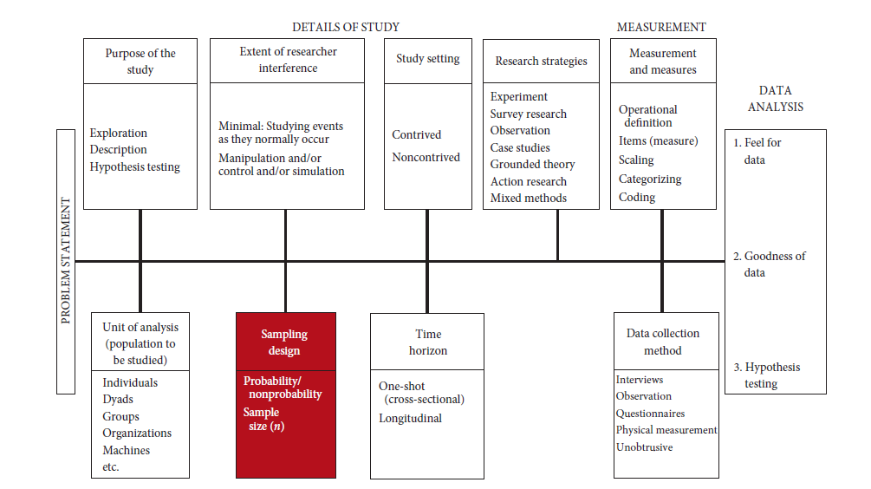
Statistics versus Parameters

Slide 13
Why use Samples
To reduce the time and cost of data collection.
It is cheaper to collect data from a sample than from an entire population.
Also, sample information can be collected and summarised more quickly since fewer elements are involved.
By concentrating on fewer elements,
more comprehensive data can be obtained from the sample than in a census.
In investigations where data collection leads to the destruction of the elements observed
(e.g. in testing the lifespan of bulbs or in blood tests) , there is no alternative but to sample.

Slide 14
Advantages of Sampling
Less costs
Less errors due to less fatigue
Less time
Destruction of elements avoided

Slide 15
Sample Selection
When we have to draw a sample from the total population, we are confronted with the following key questions:
What is the group of people/things/elements (Study population) from which we want to draw a sample?
How many people/elements do we need in our sample?(sample size)
How will these be selected? (Sampling Methods)

Slide 16
The Sampling Process
Major steps in sampling:
Define the population.
Determine the sample frame
Determine the sampling design
Determine the appropriate sample size
Execute the sampling process

Slide 17
Sampling Techniques
Probability versus nonprobability sampling
Probability sampling:
elements in the population have a known and non-zero chance of being chosen
Probability Sampling
Simple Random Sampling
Systematic Sampling
Stratified Random Sampling
Cluster Sampling
Nonprobability Sampling
Convenience Sampling
Judgment Sampling
Quota Sampling

Slide 18
Types of Sampling Methods
Random Sampling (Probability or Statistical Sampling)
A random sample is one in which the units of analysis have been selected from the sampling frame (or sometimes directly from the population) by a process involving the use of random numbers. Random sampling is structured so that all units within a population (or subset of the population) have an equal chance of being selected.
Random sampling is presumed to be done “without replacement” meaning that once a unit is selected to be in the sample, it is not placed back in the sampling frame and eligible to be sampled for second or third time.

Slide 19
Random Sampling (Cont’d)
Note:
Random sampling is not the same as chance sampling, such as interviewing the first thirty patients who happen to visit the health clinic during your site visit.
It is also not the same as deliberately selecting units to be representative of the population.
Both of these are “non-random samples” and will be discussed later in this presentation

Slide 20
Probability Sampling Theory
The purpose of sampling is to select a set of elements in a given population
in such way that the description of those elements accurately portrays the characteristics of the total population from which they are selected.
Random selection is key to a probability sample.
In random selection each element has an equal chance of selection, which is independent of any other event in the selection process.
Why Random Selection?
Serves as a check against conscious or unconscious bias on the part of the researcher
It offers access to the body of probability theory, which in turn provides the estimates of population characteristics as well as estimates of Error.

Slide 21
Simple Random Sampling
Procedure
Each element has a known and equal chance of being selected
Characteristics
Highly generalizable
Easily understood
Reliable population frame necessary

Slide 22
Types of Sampling Design
Simple Random Sampling
A Simple Random Sample
is a sample that is selected in such a way that samples of the same size have equal chances of being selected.
Consequently, all individual elements in the population would have the same chance of being selected.
Simple Random Samples are selected using a table of random numbers and requires to assign numbers to all elements/units in the sampling frame before the sample can be drawn.

Slide 23
Systematic sampling
Procedure
Each n^{th} element, starting with random choice of an element between 1 and n
Characteristics
Idem simple random sampling
Easier than simple random sampling
Systematic biases when elements are not randomly listed

Slide 24
Types of Sampling Design (Cont’d)
Systematic Sampling
A Systematic Sample is a sample obtained by randomly selecting one element from the first k elements in the frame and every k^{th} element thereafter.
Systematic sampling provides an alternative to Simple Random Sampling especially if a good sampling frame is not available. It is also easier to perform in the field hence is less subject to selection errors by field workers.
Note: When the population is repetitive or cyclic in nature (e.g. rainfall, sale of luxurious items etc), systematic sampling should not be used.

Slide 25
Cluster sampling
Procedure
Divide of population in clusters
Random selection of clusters
Include all elements from selected clusters
Characteristics
Intercluster homogeneity
Intracluster heterogeneity
Easy and cost efficient
Low correspondence with reality

Slide 26
Types of Sampling Design (Cont’d)
Cluster Sampling
A Cluster Sample
is obtained by first grouping the elements of the population into clusters and then simple random sampling or other type of sampling is used to select the clusters.
This type of sampling is used when a sampling frame cannot be prepared for individual units in the population but can be prepared for some cluster of them or when substantial time or expense can be saved by collecting data from a modest number of clusters.

Slide 27
Cluster Sampling (Cont’d)
Cluster sampling is similar to stratification in that both involve partitioning the population into sub-groups. However, while in stratified sampling the elements within a stratum are relatively homogeneous and cannot be used as a representative subset of the population, in cluster sampling, the elements in each cluster are relatively heterogeneous and each cluster can be used as a representative subset of the population.
In cluster sampling, all elements of the sampled clusters are observed.
Since elements within a cluster are often physically together, they tend to have similar characteristics. This means the amount of information about a population parameter may not be increased substantially by taking many measurements within a cluster. Hence, a cluster sample consisting of many small-sized clusters is likely to yield better information than one with few large size clusters.

Slide 28
Cluster Sampling (Cont’d)
When drawing a cluster sample,
the first task is to specify appropriate clusters.
In doing so, consideration has to be made about the level of heterogeneity of elements within clusters.
If clusters are generally heterogeneous, then few large clusters may be selected to constitute the sample but if they are homogeneous, then many small-sized clusters should be used.

Slide 29
Stratified sampling
Procedure
Divide of population in strata
Include all strata
Random selection of elements from strata
Proportionate
Disproportionate
Characteristics
Interstrata heterogeneity
Intrastratum homogeneity
Includes all relevant subpopulations

Slide 30
Types of Sampling Design (Cont’d)
Stratified Random Sampling
The sample is drawn by first dividing the population into homogeneous sub-populations (strata) and then drawing simple random samples from each of the sub-population (stratum).
It ensures proportionate representation of key characteristics when drawing a sample from a heterogeneous population and hence increases the quantity of information for a given cost.

Slide 31
Stratified Random Sampling (Cont’d)
Procedure 1:
Sort all the numbered units of the sampling frame into their appropriate strata. The strata can be defined by more than one dimension – for instance recent and older projects, and also small and large investments.
Decide the size of the sample you want to draw from each stratum. Then sample from each stratum exactly as for simple random sample.
Procedure 2:
Make a tally sheet to represent each stratum. Decide the size of the sample that you want from each stratum and record and circle that number in the appropriate cell of the tally sheet. Sample from the full sampling frame, just as for a simple random sample, but after drawing each unit check its strata characteristics and record the units number in the cell of the tally sheet that corresponds with those characteristics.

Slide 32
(Dis)proportionate stratified sampling
Number of subjects in total sample is allocated among the strata (dis)proportional to the relative number of elements in each stratum in the population
Disproportionate case:
strata exhibiting more variability are sampled more than proportional to their relative size
requires more knowledge of the population, not just relative sizes of strata

Slide 33
Types of Sampling Design (Cont’d)
Disproportionate Sampling
Disproportional stratified random samples are used to improve the precision of inferences made to an individual stratum and comparisons among the strata.
It comes into play when one wishes to sample some population disproportionately to ensure sufficient number of cases from each group for analysis.

Slide 34
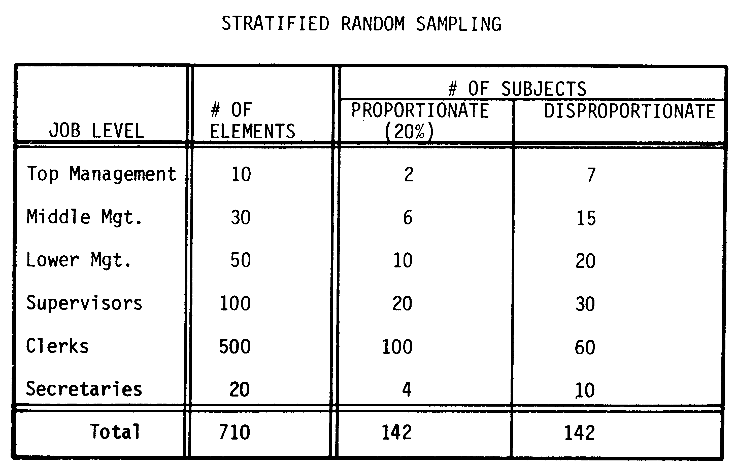
Example

Slide 35
Types of Sampling Design (Cont’d)
Multi Stage Cluster Sampling
In this type of sample, a random cluster sample is drawn, then units within the clusters are randomly selected. The second phase of sampling can be a cluster sample (e.g. sub-counties within a district), a stratified random sample or a simple random sample. More than two stages of sampling are possible, such as from regions, districts, sub-counties, schools to classrooms.

Slide 36
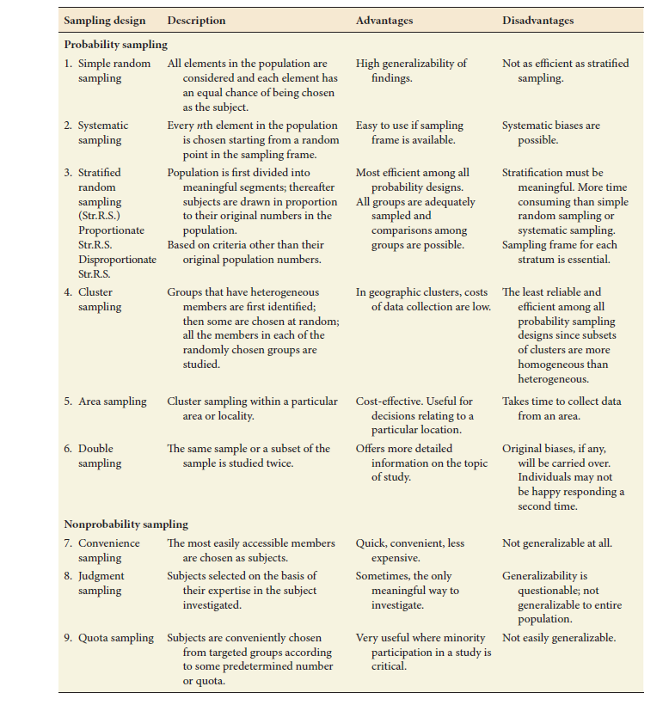
Overview

Slide 37
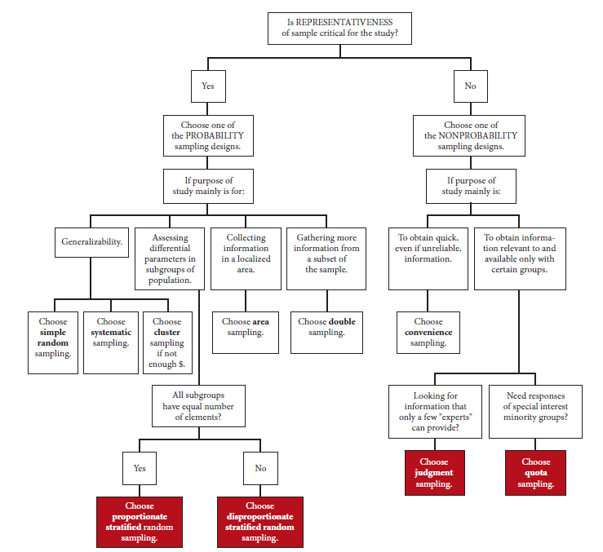
Choice Points in Sampling Design

Slide 38
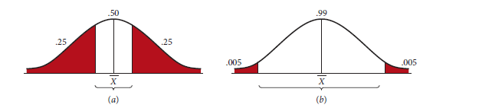
Tradeoff between precision and confidence
We can increase both confidence and precision by
increasing the sample size

Slide 39
Sample size: guidelines
In general: 30 < n < 500
Categories: 30 per subcategory
Multivariate: 10 x number of var’s
Experiments: 15 to 20 per condition

Slide 40
NON-RANDOM SAMPLING
A non-random sample (Non-Probability Sample) is one in which the units of analysis have been selected from the sampling frame by convenience (such as the women at a market on the morning that the Researcher/evaluator makes a visit there) or for the purposes of representing certain characteristics of the population that are of particular interest.
Non-random samples are usually used in qualitative research methods. They are used in instances where the elements of the population do not have a well-defined chance of being selected. Here, the representativeness of the sample is not a major issue.

Slide 41
Non-Random Sample (cont’d)
Rules of the Game
Non-random samples serve legitimate purposes, but those purposes need to be kept in mind when making inferences from the sample.
Non-random samples should not be used in infer generalizations about the whole population. In addition, statistical testing and confidence intervals should never be computed from non-random samples because those procedures assume random samples.

Slide 42
Types of Non-Random Samples
Convenience (haphazard, accidental sample)
The most easily available units from the population are selected because they are convenient for the Researcher/evaluator.
Units could be selected because they show up at a convenient time or place for data collection. They may be selected because you encounter the units first, or because the units volunteer to provide needed information. The researcher may simply stand at the entrance of a market or a street corner and interview people who pass by.

Slide 43
Types of Non-Random Samples (cont’d)
Snowball (Chain Sample)
When the boundaries of the population are unknown, and there is no sampling frame, sometimes a few encountered units of analysis can lead the researcher/evaluator to other units.
For example, in a commission of inquiry or in a criminal investigation, interrogation of a few suspects/witnesses usually leads to a chain of other suspects/witnesses who can also be interrogated. Researchers also commonly snowball the bibliography of their background research, checking found documents for references to other relevant documents.

Slide 44
Types of Non-Random Samples (cont’d)
Quota Sample:
In this type of sampling, units are selected proportionally (but not randomly) from given strata of interests.
Begins with a matrix describing the characteristics of the target population such as sex, age, and education composition. When such matrix has been created and a proportion assigned to each cell in the matrix, the researcher collects data from a person having all the desired characteristics. All the persons in the given cell are then assigned a weight appropriate to their portion of the population when all the sample elements are so weighed.

Slide 45
Types of Non-Random Samples (cont’d)
Maximum Variation (heterogeneity) Sample
Units are drawn to represent the range of some characteristic of interest.
The researcher/evaluator draws units to represent the range of some characteristics that is thought likely to affect the outcomes of interest. The characteristics can be measured numerically or categorically. (height in inches or brown eyes)

Slide 46
Types of Non-Random Samples (cont’d)
Confirming and Disconfirming Cases Sample
Units are drawn from cases known to be successful and those known to be unsuccessful to try to determine what accounts for the differences.
Units are drawn from project sites known to confirm and contradicts some established or developing theory, and then examined to determine what accounts for the differences and refine the theory.

Slide 47
Types of Non-Random Samples (cont’d)
Extreme Cases Sample
Units are drawn from the extreme cases of some characteristics of interest, such as oldest and most recent cases.
Units are drawn from both extremes of some characteristics that is thought likely to affect project success. Generally this can be done only for characteristics measured

Slide 48
Types of Non-Random Samples (cont’d)
Criterion sample
All units in the population that meet a specific criterion are selected, such as all senior officer in UPDF or all participants collar pimps, Student in ‘A’ ; ‘O’ or University
The researcher/evaluator selects every unit in population that has a certain specified characteristic.

Slide 49
Advantages of Random Samples
Random samples are almost always preferable when the intent is to generalize from the sample to an entire population. They eliminate the chance that the evaluator will bias the selection of the sample- either consciously or unconsciously.
Random samples entail procedures for estimating the extent of sampling error. These procedures are applied each time one conducts a test of statistical significance or computes confidence intervals.

Slide 50
Advantages of Non-Random Samples
Several non-random samples have very legitimate objectives, but they generally create the risk of evaluator bias in the selection process unless the population is so small that no discretion is needed in selecting among eligible units in the population.
One can always compare the prevalence of the characteristics of concern in the population with their prevalence in the sample, but that only assures that sample is representative of characteristics known at the time of sampling, whereas sampling is undertaken to collect data on additional characteristics not yet known.

Slide 51
Types of Cluster Sampling
Fig. 11.3
Cluster Sampling
One-Stage
Sampling
Two-Stage
Sampling
Multistage
Sampling
Simple Cluster
Sampling
Probability
Proportionate
to Size Sampling

Slide 52
Strengths and Weaknesses of Basic Sampling Techniques
Table 11.3
Technique
Strengths
Weaknesses
Nonprobability Sampling
Least expensive, least
Selection bias, sample not
Convenience sampling
time-consuming, most
representative, not recommended for
convenient
descriptive or causal research
Judgmental sampling
Low cost, convenient,
Does not allow generalization,
not time-consuming
subjective
Quota sampling
Sample can be controlled
Selection bias, no assurance of
for certain characteristics
representativeness
Snowball sampling
Can estimate rare
Time-consuming
characteristics
Probability sampling
Easily understood,
Difficult to construct sampling
Simple random sampling
results
projectable
frame, expensive,
lower precision,
(SRS)
no assurance of
representativeness.
Systematic sampling
Can increase
Can decrease
representativeness
representativeness,
easier to implement than
SRS, sampling frame not
necessary
Stratified sampling
Include all important
Difficult to select relevant
subpopulations,
stratification variables, not feasible to
precision
stratify on many variables, expensive
Cluster sampling
Easy to implement, cost
Imprecise, difficult to compute and
effective
interpret results

Slide 53
Procedures for Drawing Probability Samples
Fig. 11.4
Simple Random Sampling
1. Select a suitable sampling frame
2. Each element is assigned a number from 1 to N (pop. size)
3. Generate n (sample size) different random numbers between 1 and N
4. The numbers generated denote the elements that should be included in the sample

Slide 54
Procedures for Drawing Probability Samples
Fig. 11.4 cont.
Systematic Sampling
1. Select a suitable sampling frame
2. Each element is assigned a number from 1 to N (pop. size)
3. Determine the sampling interval i:i=N/n. If i is a fraction, round to the nearest integer
4. Select a random number, r, between 1 and i, as explained in simple random sampling
5. The elements with the following numbers will comprise the systematic random sample: r, r+i,r+2i,r+3i,r+4i,...,r+(n-1)i

Slide 55
Procedures for Drawing Probability Samples
Fig. 11.4 cont.
Stratified Sampling
1. Select a suitable frame
2. Select the stratification variable(s) and the number of strata, H
3. Divide the entire population into H strata. Based on the classification variable, each element of the population is assigned to one of the H strata
4. In each stratum, number the elements from 1 to N_{h} (the pop. size of stratum h)
5. Determine the sample size of each stratum, n_{h}, based on proportionate or disproportionate stratified sampling, where
6. In each stratum, select a simple random sample of size n_{h}
_{H}
n_{h} = n
_{h=1}

Slide 56
Procedures for Drawing Probability Samples
Cluster Sampling
Fig. 11.4 cont.
1. Assign a number from 1 to N to each element in the population
2. Divide the population into C clusters of which c will be included in the sample
3. Calculate the sampling interval i, i=N/c (round to nearest integer)
4. Select a random number r between 1 and i, as explained in simple random sampling
5. Identify elements with the following numbers: r,r+i,r+2i,... r+(c-1)i
6. Select the clusters that contain the identified elements
7. Select sampling units within each selected cluster based on SRS or systematic sampling
8. Remove clusters exceeding sampling interval i. Calculate new population size N*, number of clusters to be selected C*= C-1, and new sampling interval i*.

Slide 57
Procedures for Drawing Probability Samples
Fig. 11.4 cont.
Cluster Sampling
Repeat the process until each of the remaining clusters has a population less than the sampling interval. If b clusters have been selected with certainty, select the remaining c-b clusters according to steps 1 through 7. The fraction of units to be sampled with certainty is the overall sampling fraction = n/N. Thus, for clusters selected with certainty, we would select n_{s}=(n/N)(N₁+N₂+...+N_{b}) units. The units selected from clusters selected under PPS sampling will therefore be n*=n- n_{s}.

Slide 58
Choosing Nonprobability vs. Probability Sampling
Table 11.4 cont.

Slide 59
Tennis' Systematic Sampling Returns a Smash
Tennis magazine conducted a mail survey of its subscribers to gain a better understanding of its market. Systematic sampling was employed to select a sample of 1,472 subscribers from the publication's domestic circulation list. If we assume that the subscriber list had 1,472,000 names, the sampling interval would be 1,000 (1,472,000/1,472). A number from 1 to 1,000 was drawn at random. Beginning with that number, every 1,000th subscriber was selected.
A brand-new dollar bill was included with the questionnaire as an incentive to respondents. An alert postcard was mailed one week before the survey. A second, follow-up, questionnaire was sent to the whole sample ten days after the initial questionnaire. There were 76 post office returns, so the net effective mailing was 1,396. Six weeks after the first mailing, 778 completed questionnaires were returned, yielding a response rate of 56%.

Slide 60
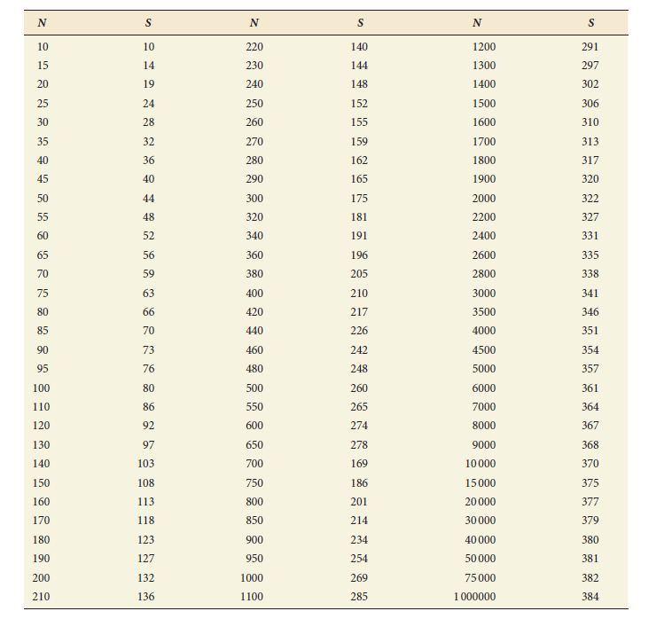
Sample Size for a Given Population Size

